Slide 1
Financial & Managerial Accounting
Lecture 01: Introduction to Accounting
Chapter
1
Masud Jahan
Department of Science and Humanities
Military Institute of Science and Technology

Slide 2
Knowing The Numbers
“To be good at your business,
you have to know the numbers—cold.”
- Harold S. Geneen
<number>/34
Notes:
You all who’ve taken this course do not plan to be accountants and you might be thinking, “If I’m not going to be an accountant, why do I need to know accounting?”
Consider the quote from Harold Geneen, the former chairman of IT&T:
“To be good at your business, you have to know the numbers—cold.”
Success in any business comes back to the numbers. You will rely on them to make decisions, and managers will use them to evaluate your performance. That is true whether your job involves marketing, production,
management, or engineering.
In business, accounting and financial statements are the means for communicating the numbers. If you don’t know how to read financial statements, you can’t really know your business.

Slide 3
Information Age
We live in the information age- a time of communication, data, news and facts.
<number>/34
Notes:
Access to and understanding of information affect how we live and the opportunities we have. To take advantage of the information, we need knowledge of the information system.

Slide 4
Information System
Collecting Information,
Processing Information, and
Communicating Information
<number>/34
Notes:
An information system is the collecting, processing, and communicating of information to decision makers.
Understanding and processing information is the core of information system.

Slide 5
Accounting, an Information System
Collects Financial Information,
Processes Financial Information, and
Communicates Financial Information
<number>/34
Notes:
Accounting is an information system that collects, processes and communicates financial information to interested users about an organization useful in making decisions.
Financial information may include sales, expenses, taxes and any other figure of an economic event.
Economic event is an event which causes changes to the financial position of an organization.

Slide 6
Users Of Accounting Information
There are two broad categories of accounting information users:
  External Users
  Internal Users.
<number>/34

Slide 7
External Users & Their Need
External users are parties outside the business who are interested in the accounting information.
They include investors, creditors, taxing authorities etc.
<number>/34
Notes:
Investors use accounting information to make buy, sell or keep decisions related to shares, bonds, etc.
Creditors (suppliers, banks) utilize accounting information to make lending decisions.
Taxing authorities (Internal Revenue Service) need accounting information to determine a company's tax liabilities.

Slide 8
Internal Users & Their Need
Internal users are parties inside the business who are interested in the accounting information.
Internal users are owners and managers of the business.
<number>/34
Notes:
A company's management uses accounting information to run the business.

Slide 9
Types of Accounting
There are mainly two types of accounting:
  Financial Accounting
  Managerial Accounting
<number>/34
Notes:
Financial accounting provides information that is designed to satisfy the needs of external users.
Managerial accounting provides information that is useful in running a company by internal users.

Slide 10
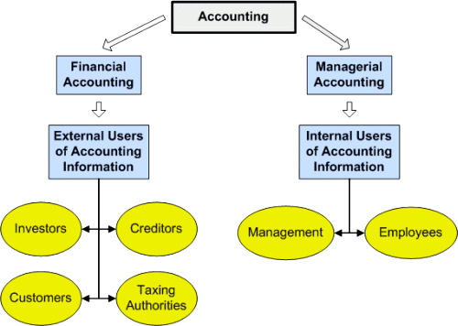
Illustration
<number>/34

Slide 11
Organizations
Business Organization is one or more individuals selling products or services for profit.
Nonbusiness Organization is one or more individuals serve us in ways not always measured by profit.
<number>/34
Notes:
Organizations: A person or body of persons organized for some specific purpose. Organizations can be classified as either business or nonbusiness.

Slide 12
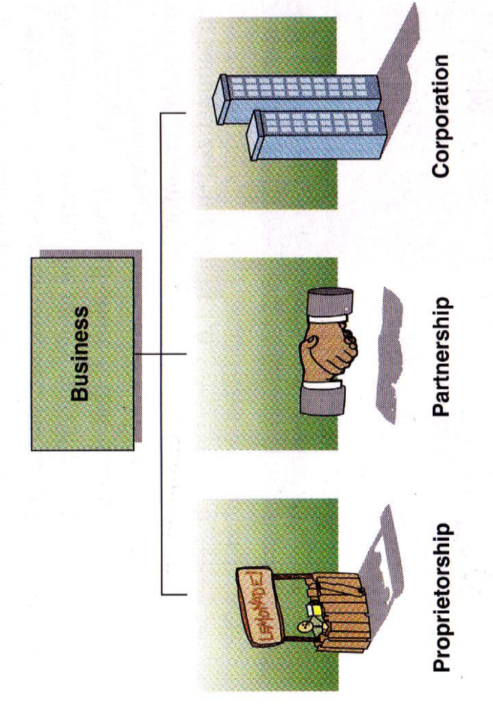
Forms of Business Organizations
.
<number>/34

Slide 13
Single Proprietorship
A proprietorship is owned by one individual.
Advantages
Ease in organizing
Low cost of organizing
Disadvantage
Limited source of financial resources
Unlimited liability
X’s
<number>/34

Slide 14
Partnership
Advantages
More financial resources than a proprietorship.
Additional management skills.
A partnership is owned by two or more individuals.
X & Y’s
Disadvantage
Unlimited liability.
<number>/34

Slide 15
Corporation
A corporation is organized under state or federal statutes as a separate legal entity.
Advantage
The ability to obtain large amounts of resources by issuing shares.
Limited liability.
X & Y, Inc.
Disadvantage
Double taxation.
<number>/34

Slide 16
Types of Business
Service companies
  Provide services for a fee.
Merchandising companies
  Purchase goods that are ready for sale and then resell them to customers.
Manufacturing companies
  Buy materials, convert them into products, and then sell the products to other companies or to final customers.
<number>/34

Slide 17
End of Lecture 01 thank you all…

